Slide 1
Personal
project

Slide 2

ABOUT THE PROJECT
Designed and developed an Electronic Accounting Management System aimed at facilitating accounting operations and improving work efficiency. Implemented using modern technologies such as PHP, MySQL, and HTML

Slide 3

FUNCTIONREQUIREMENTS
1- Allow normal employee to submit maintenance requests via a web form.
2- Store request data in a MySQL database.
3- Enable admin to view login logs
4- Enable normal employees to view their previous requests
5- Allow the Technical to update the status of each request.
6- Provide create new user for admin access only.
7- Display all requests in a table with key details (e.g., name, issue, status).

Slide 4

NON-FUNCTIONAL REQUIREMENTS
1- Safety
2- speed
3- Encryption
4- Ease of use

Slide 5

SYSTEM-DESIGN:
Implemented a login system to restrict access to the admin dashboard.
Focused on core features such as submitting and managing maintenance requests.
Structured the database to store user requests and status updates efficiently.

Slide 6
TECHNOLOGIES USED
Programming Languages: PHP, HTML, CSS , JS
Database:MYSQL
Development Environment: XAMPP, NetBeans, Visual Studio
Design Tools: Draw.io, Microsoft Access

Slide 7
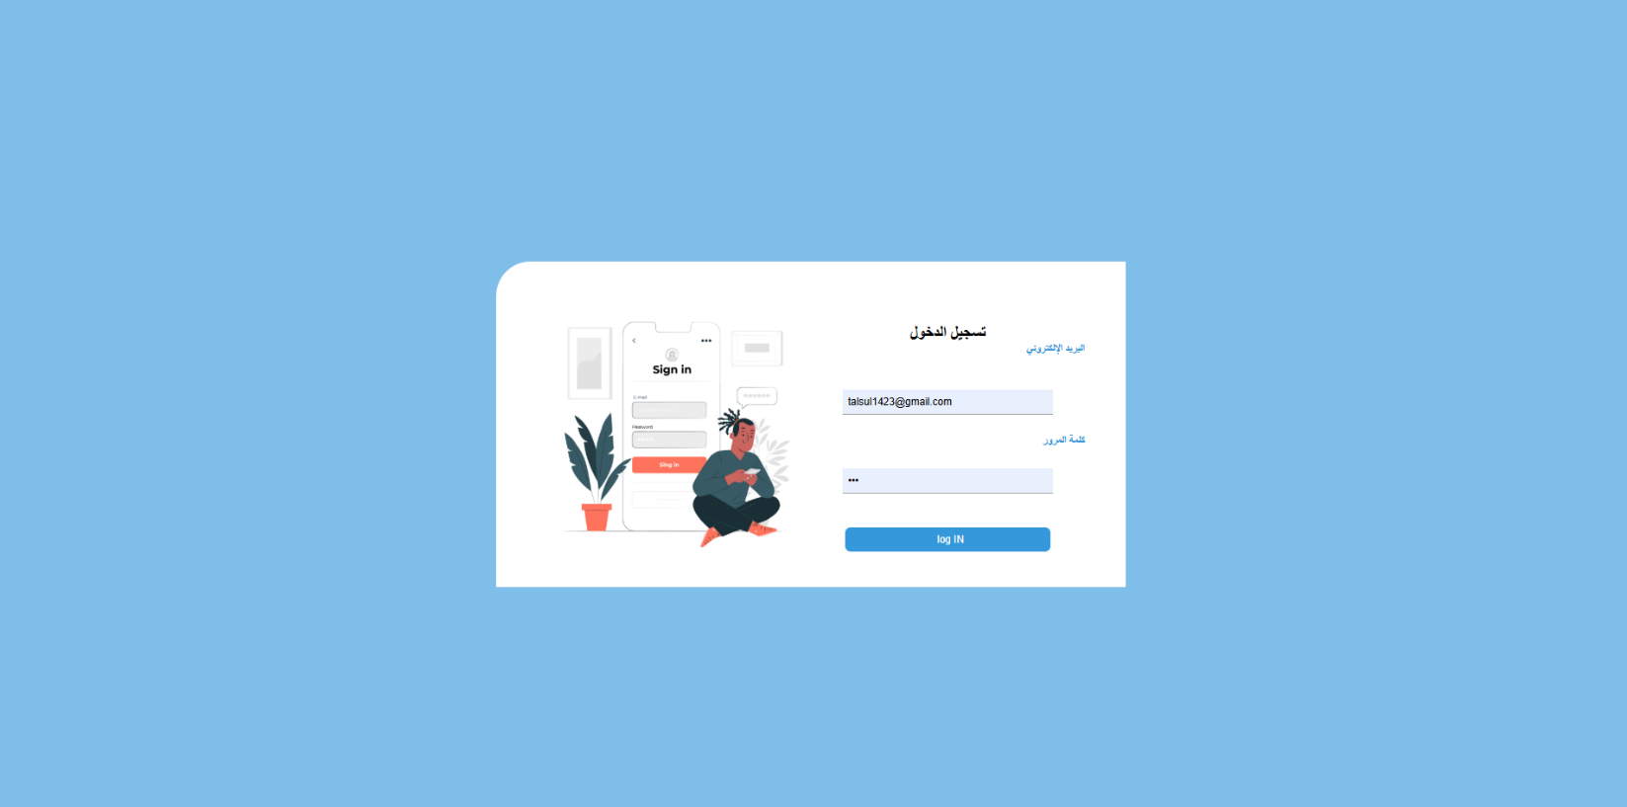
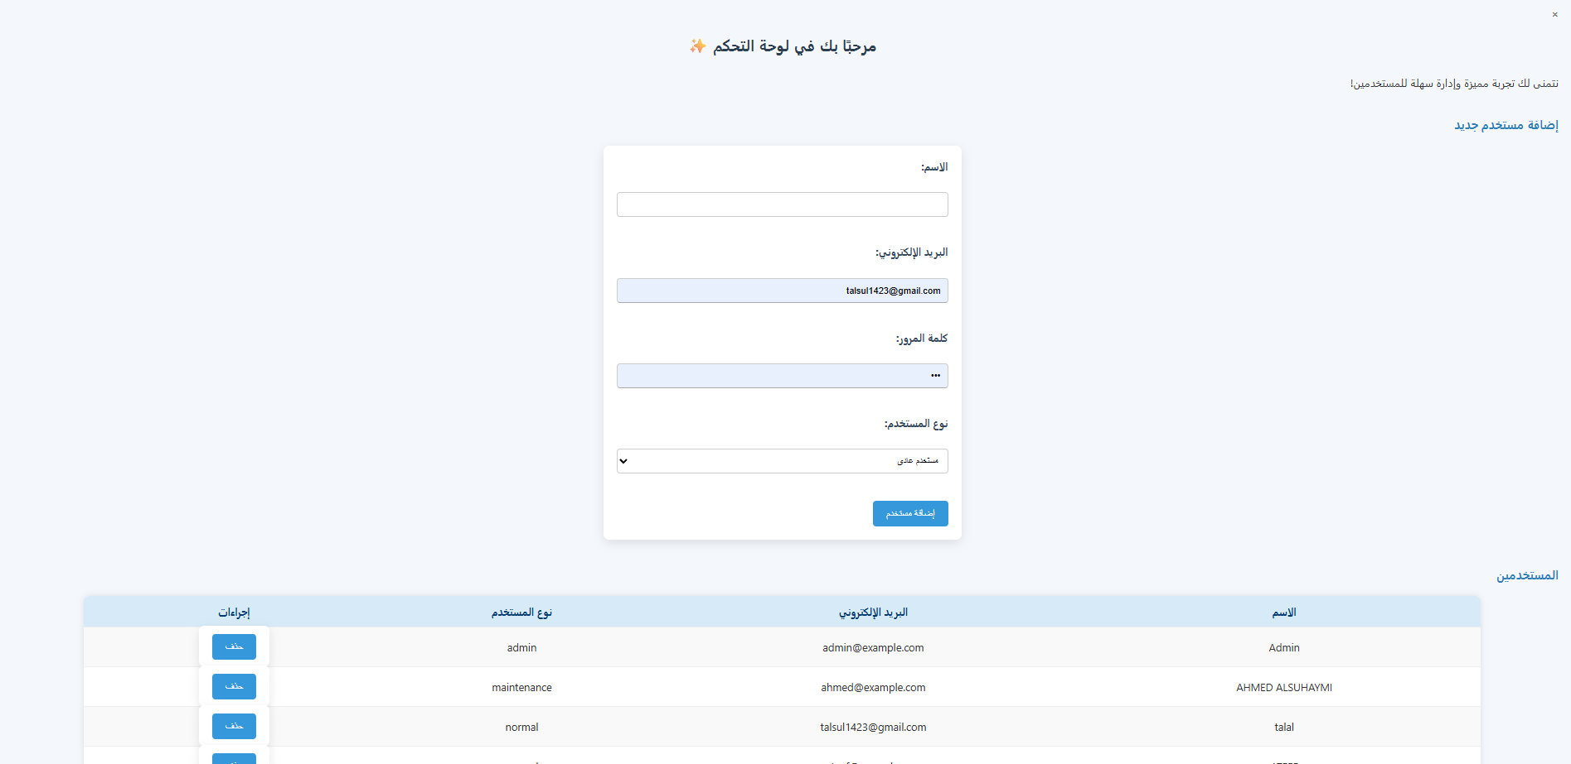
PICTURES FROM THE PROJECT
Login Page admin dashboard

Slide 8

TIME LINE
April
May
May
Database
Back-End
Front-End

Slide 9
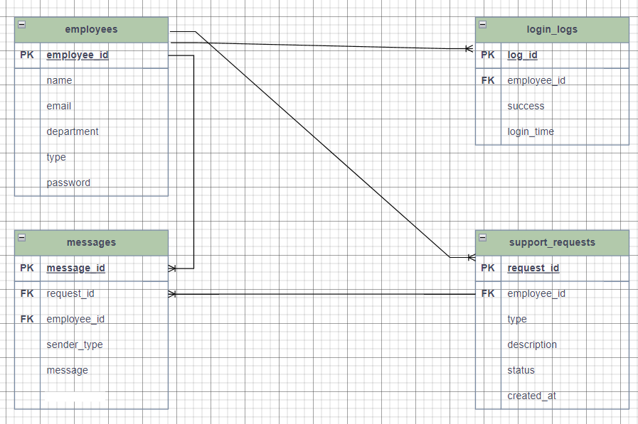
ERD DIAGRAM
The ERD for the Maintenance Request Management System was designed to represent the relationships between key entities such as users, maintenance requests, and request statuses. The main entities include:Users: Stores admin login credentials.Requests: Contains information about each maintenance request, including requester name, contact details, description, date, and status.Status: Defines the current state of each request (e.g., Pending, In Progress, Completed).The relationships between these entities ensure efficient data handling, easy tracking of requests, and streamlined workflow for maintenance management.

Slide 10
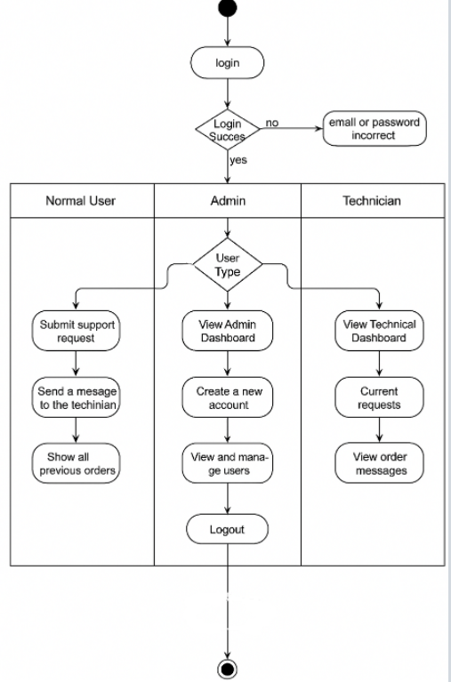
ACTIVITY DIAGRAM:

Slide 11
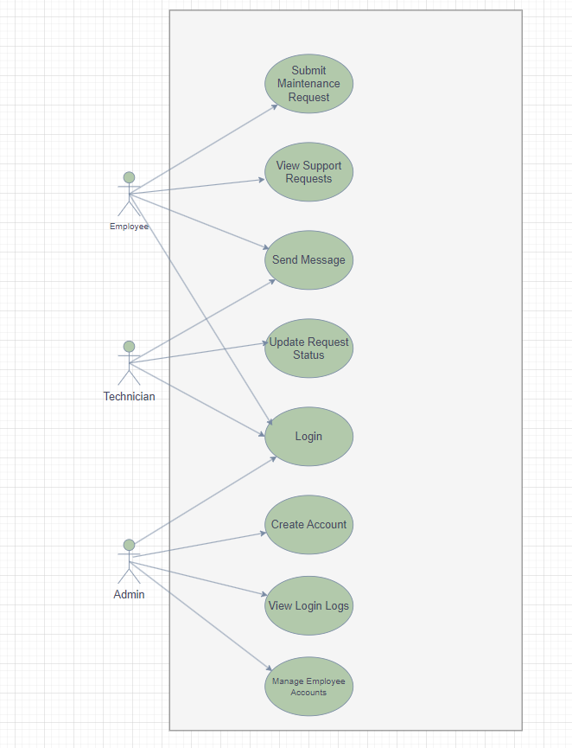
USE CASE DIAGRAM

Slide 12
TESTING
Test Case | Description | Input | Expected Result | Pass/Fail
TC01 – Submit Request | Test submitting a maintenance request | Name + Issue description + Contact info | Request saved in database, success message displayed | Pass
TC02 – Admin Login | Test admin login functionality | Username + Password | Redirect to admin dashboard if credentials are valid | Pass
TC03 – Invalid Login | Test login with incorrect credentials | Username + Wrong password | Error message shown: "Invalid credentials" | Pass
TC04 – View Requests | Test viewing all submitted requests | None | Table showing all requests with details is displayed | Pass
TC05 – Update Status | Test updating request status | Select request + Change status | Status is updated and saved in the database | Pass
TC06 – Empty Form | Test submitting form without filling fields | Submit with empty fields | Show validation messages requesting required fields | Pass

Slide 13
Tasks I Handled
🧠 Planning & Analysis – Understanding project requirements and defining scope
🗂️ Database Design – Creating ERD and building MySQL tables
🖥️ Frontend Development – Designing user interface using HTML, CSS, and JavaScript
⚙️ Backend Development – Building system logic using PHP and connecting to the database
🔐 Authentication – Implementing admin login system
🔍 Testing – Performing manual tests to ensure functionality and fix bugs
📝 Documentation – Writing reports and describing system structure clearly

Slide 14
THANKS FOR YOUR TIME.

